Slide 1
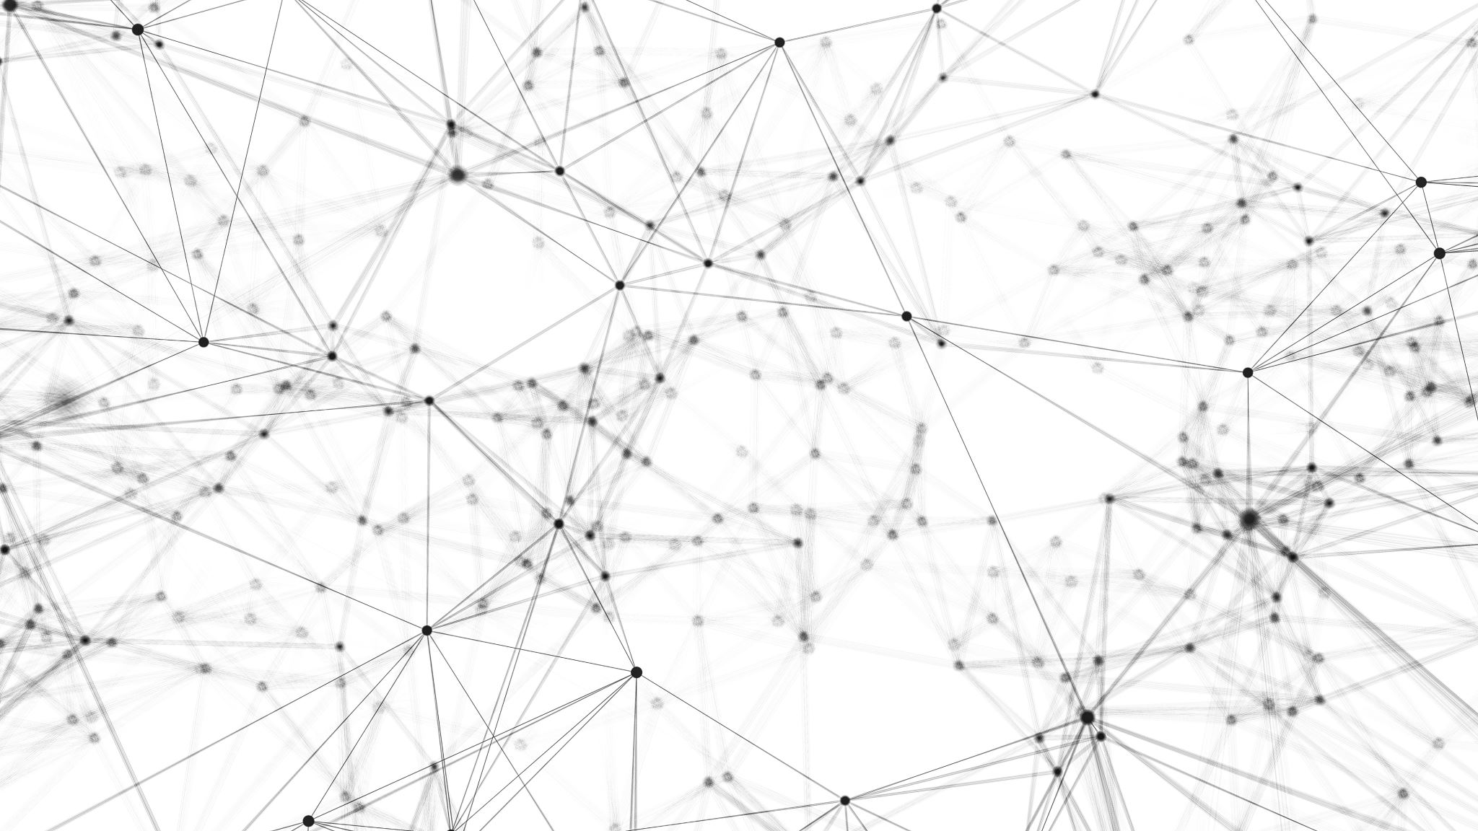
Power and Bandwidth Allocation in Multibeam Satellite Systems

Slide 2

Dynamic Resource Management
Notes:
New generations of communications satellites will provide hundreds of Gbps of throughput by using advanced digital payloads, which will allow for
1. beam-steering
2. beam-shaping
3. individual allocation of power and bandwidth for each beam.
Therefore, dynamic resource management (DRM) techniques for communications satellites will be crucial for operators to fully exploit the capabilities of their satellites.

Slide 3

Our Goal
Notes:
Our goal is to presents a method for joint power and bandwidth allocation in multibeam satellite systems.
To that end, we first develop a multibeam satellite model that accounts for
1. propagation effects,
2. interference among beams,
3. and atmospheric attenuation.
Next, we formulate the joint power and bandwidth allocation optimization problem, whose basis is hybrid genetic algorithm.
We'll propose a pythonic model to solve this problem.

Slide 4

Spot Beam Satellite
Most Significant advancements leading to increase in capacity in modern satellite.
In a spot beam the signal power is focused on a specific area of the Earth’s surface, being the beam’s footprint on the order of several hundreds of kilometers

Slide 5
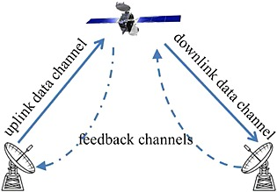
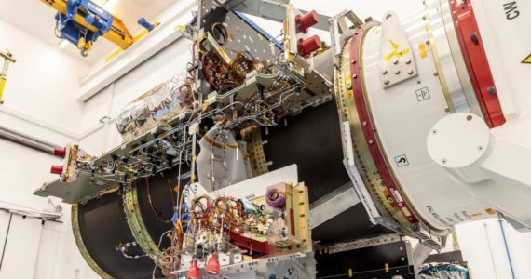
Transition
Notes:
operators are transitioning from rigid bent-pipe architectures towards flexible and reconfigurable satellite architectures. In newer designs analog payloads are replaced with digital payloads, which allow for dynamic on-demand resource allocation https://youtu.be/0iKgOahW5y0

Slide 6
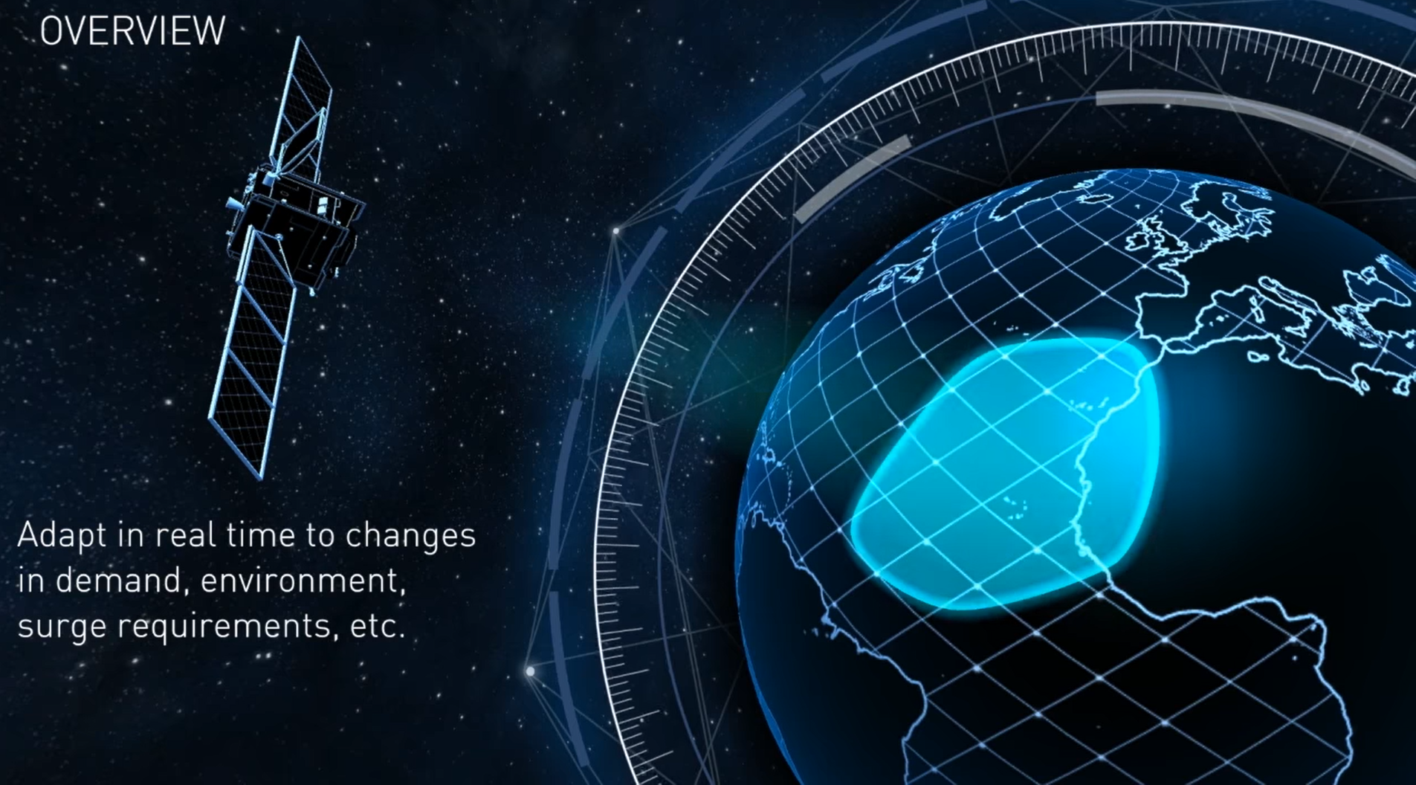

Slide 7
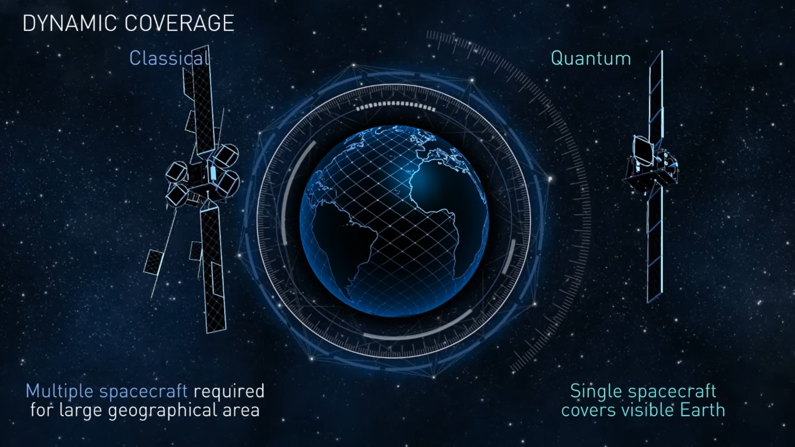

Slide 8
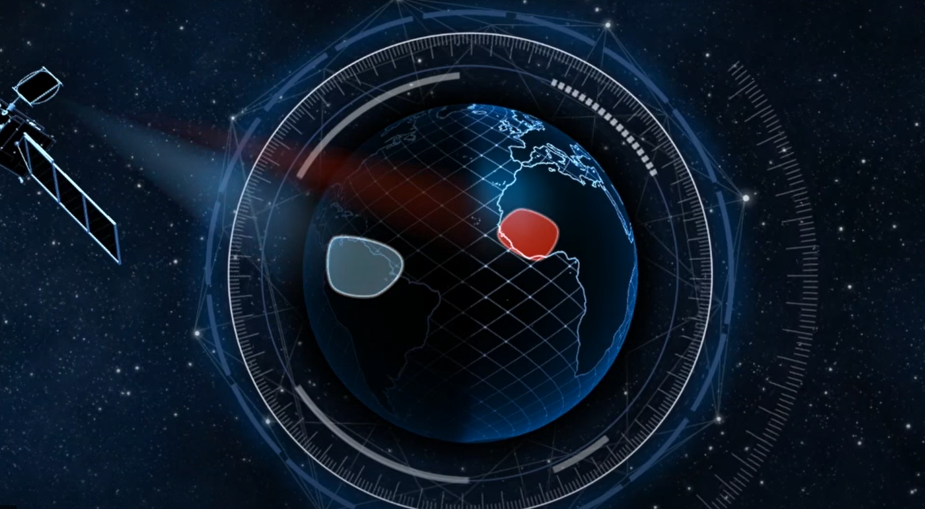

Slide 9

System Model
Notes:
For this project we have worked on Link Budget Model. The other models that you can find are
1. Interference Models
2. Atmospheric Attenuation Model

Slide 10
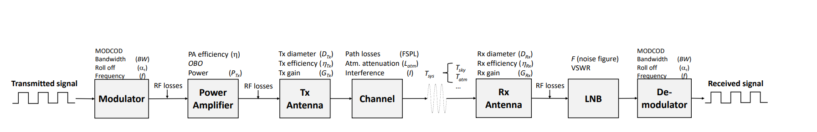
Link Budget Model

Slide 11
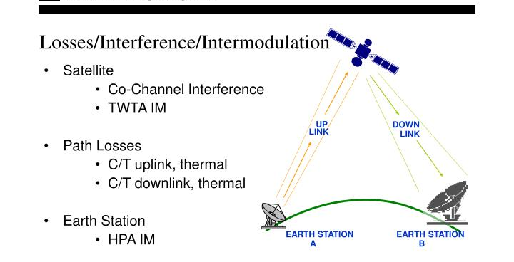
Notes:
Link budget equaltion is used to compute the achievable date rate for each of the beams.

Slide 12

Link Budget Equaltion
We have used 6 Equation to compute the link
Calculation of Signal to Noise Ratio (SNR)
Calculation of Loss due to atmoshphere and other factors
System Tempreature
Calculation of Signal to Interference plus Noise Ratio (SINR)
Energy per bit to Noise + Interfernce Ratio
Beam Data Rate

Slide 13

Problem Statement
Notes:
We consider a satellite with N fixed-pointing beams and Our objectve is to assign an average power and bandwidth to each of the N beams , such that the unmet system capacity (USC) is minimized

Slide 14
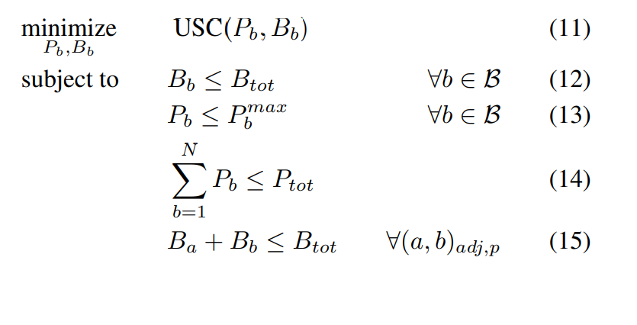

Slide 15

Future Work
We are going to implement Hybrid Genetic Algorithm to Solve this Optimization Problem and Code this in Python. We are going to use DEAP python library to solve our problem

